Slide 1


Slide 2

JEOPARDY BOARD
FINAL JEOPARDY
Turtle Up | Sea Turtles | Ghana | More Sea Turtles | Dates
$100 | $100 | $100 | $100 | $100
$200 | $200 | $200 | $200 | $200
$300 | $300 | $300 | $300 | $300
$400 | $400 | $400 | $400 | $400
$500 | $500 | $500 | $500 | $500

Slide 3

TurtleUp - $100 Question
True or False: TurtleUp’s mission is to sustainability preserve & conserve Ghana’s sea turtles by embracing a community-based approach
Click to see answer

Slide 4

TurtleUp - $100 Answer
True!
Click to return to Jeopardy Board

Slide 5
TurtleUp - $200 Question
What does TurtleUp offer to students?
Click to see answer

Slide 6
TurtleUp - $200 Answer
A hands-on immersive eco trip to Ghana, Africa
Click to return to Jeopardy Board

Slide 7
TurtleUp - $300 Question
Out of a survey of 130 participants, what interests students the most about the study abroad program?
Focusing on environmental conservation
Competitive price
Improving intercultural competency
Click to see answer

Slide 8
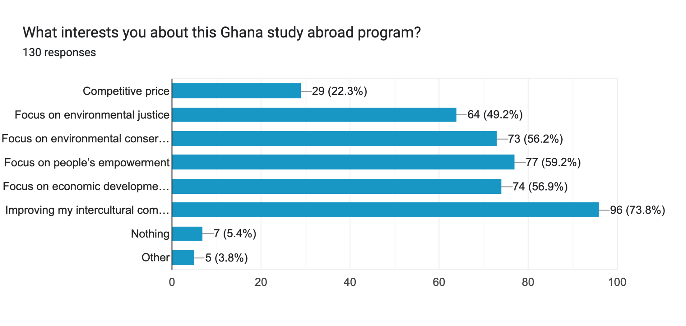
TurtleUp - $300 Answer
C) Improving intercultural competency
Click to return to Jeopardy Board

Slide 9
TurtleUp - $400 Question
What competition did TurtleUp recently compete in?
Click to see answer

Slide 10
TurtleUp - $400 Answer
FlyerPitch
Click to return to Jeopardy Board

Slide 11
TurtleUp - $500 Question
What city will the study abroad trips take place?
Click to see answer

Slide 12
TurtleUp - $500 Answer
New Ningo Prampram, Ghana
Click to return to Jeopardy Board

Slide 13
Sea Turtles - $100 Question
How many species of sea turtles are there?
Click to see answer

Slide 14
Sea Turtles - $100 Answer
7
Click to return to Jeopardy Board

Slide 15
Sea Turtles - $200 Question
Approximately how many years have sea turtles existed?
10 million years
50 million years
130 million years
250 million years
Click to see answer

Slide 16
Sea Turtles - $200 Answer
c) Over 130 million years!
Click to return to Jeopardy Board

Slide 17
Sea Turtles - $300 Question
Fill in the blank: _ out of 1,000 hatchlings survive to adulthood
Click to see answer

Slide 18
Sea Turtles - $300 Answer
ONE
Click to return to Jeopardy Board

Slide 19
Sea Turtles - $400 Question
Where do sea turtles lay their eggs?
Bottom of the ocean
Floating nest
Where they were born
Click to see answer

Slide 20
Sea Turtles - $400 Answer
C! Adult sea turtles return to the beach on which they were born to lay their own eggs
Click to return to Jeopardy Board

Slide 21
Sea Turtles - $500 Question
Which of the following is NOT a species of sea turtle?
Flatback
Green Turtle
Olive Ridley
Greenback
Click to see answer

Slide 22
Sea Turtles - $500 Answer
D is not correct. The 7 species are: Flatback, Kemps Ridley, Olive Ridley, Loggerhead, Hawksbill, Green Turtle, Leatherback
Click to return to Jeopardy Board

Slide 23
Ghana - $100 Question
What continent is Ghana located in?
Click to see answer

Slide 24
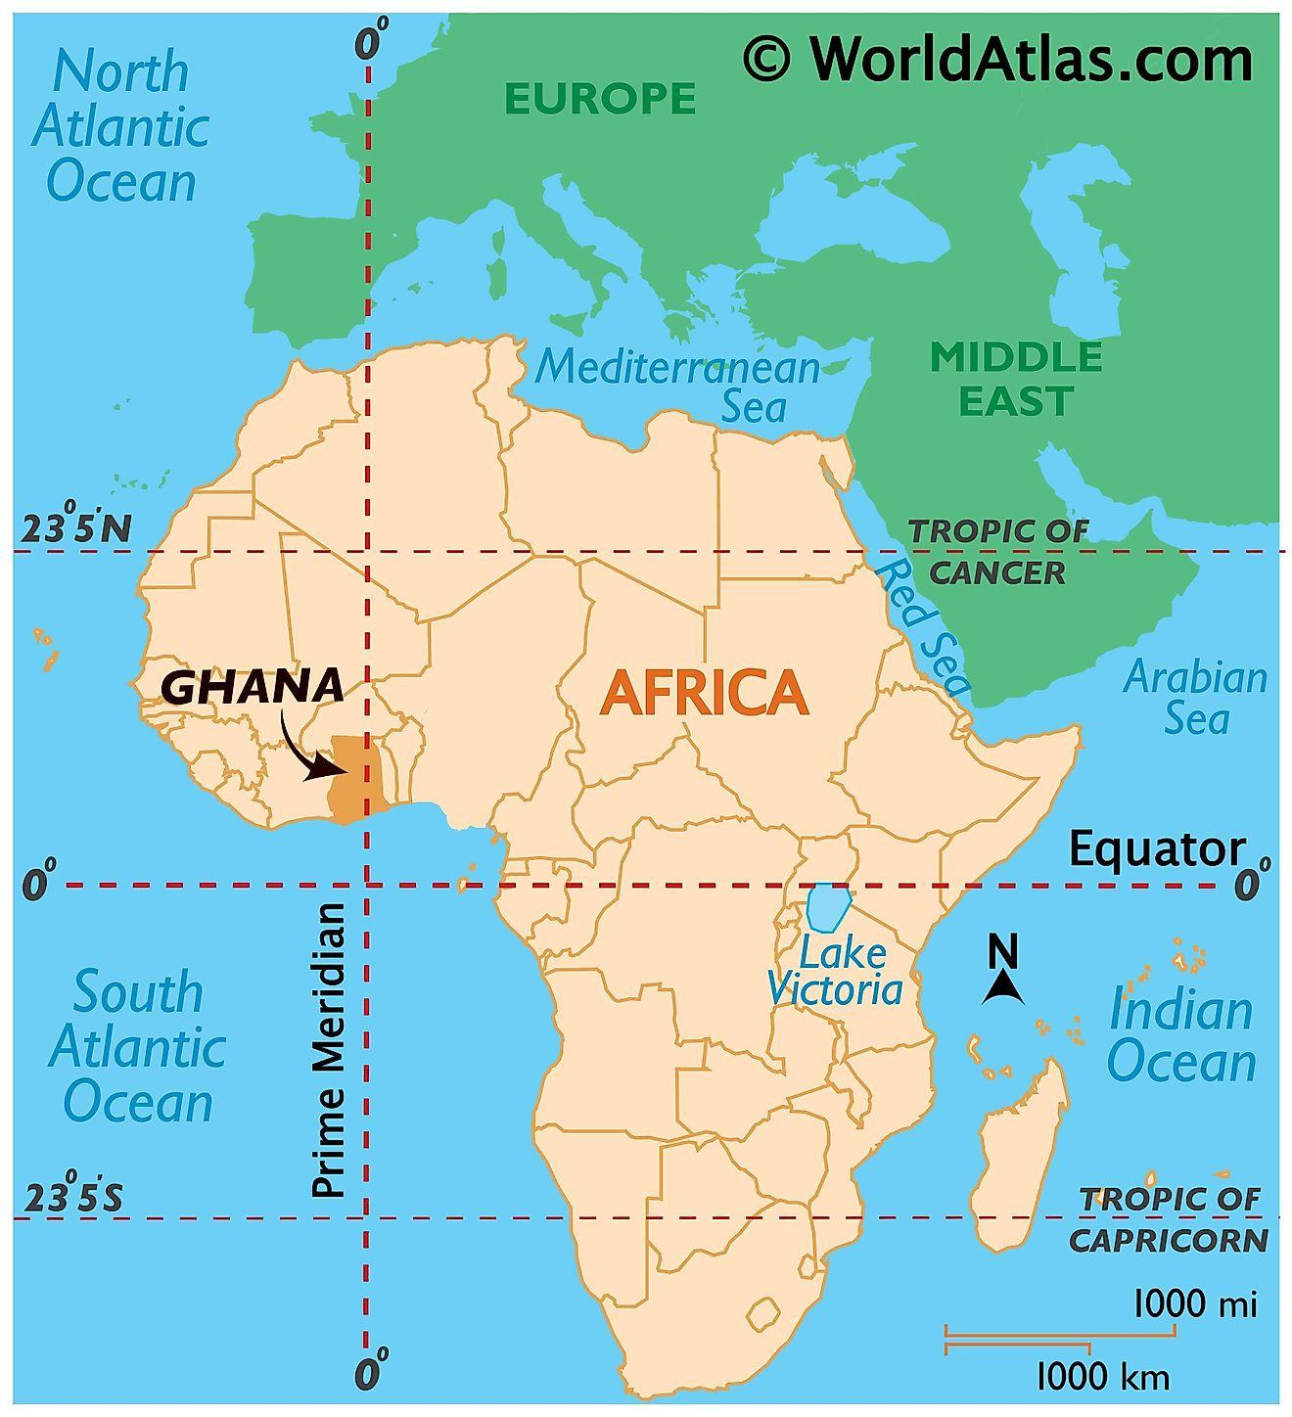
Ghana - $100 Answer
Africa
Click to return to Jeopardy Board

Slide 25
Ghana - $200 Question
What is the estimated population of Ningo Prampram, Ghana?
(hint: hundred thousands)
Click to see answer

Slide 26
Ghana - $200 Answer
About 200,000 people
Click to return to Jeopardy Board

Slide 27
Ghana - $300 Question
What is Ghana’s official language?
Click to see answer

Slide 28
Ghana - $300 Answer
English! However, English is not the most spoken language in the country.
Twi is the most spoken language
Click to return to Jeopardy Board

Slide 29
Ghana - $400 Question
What is the capital city of Ghana?
Click to see answer

Slide 30
Ghana - $400 Answer
Accra
Click to return to Jeopardy Board

Slide 31
Ghana - $500 Question
What is Ghana’s Timezone?
Click to see answer

Slide 32
Ghana - $500 Answer
Greenwich Mean Time (GMT)
4 hours ahead of ET
Click to return to Jeopardy Board

Slide 33
More Sea Turtles - $100 Question
True or False: Sea turtles can breathe underwater
Click to see answer

Slide 34
More Sea Turtles - $100 Answer
False!
Click to return to Jeopardy Board

Slide 35
More Sea Turtles- $200 Question
Name one of the major threats that sea turtles face
Click to see answer

Slide 36
More Sea Turtles - $200 Answer
Coastal development
Pollution/Plastic
Invasive species
Climate change
Fishing gear
Overharvesting
Click to return to Jeopardy Board

Slide 37
More Sea Turtles - $300 Question
What can a sea turtle’s tail tell you about them?
Click to see answer

Slide 38
More Sea Turtles - $300 Answer
The size of the tail can be used to distinguish between males and females. Males develop much longer tails than females
Click to return to Jeopardy Board

Slide 39
More Sea Turtles - $400 Question
How many sea turtle species are classified as endangered?
Click to see answer

Slide 40
More Sea Turtles - $400 Answer
All 7 of them! 3 species are critically endangered
Click to return to Jeopardy Board

Slide 41
More Sea Turtles - $500 Question
Name 2 ways to save sea turtles!
Click to see answer

Slide 42
More Sea Turtles - $500 Answer
Coastal cleanups
Reduce plastic use
  Reusable water bottles & shopping bags
Keep nesting beaches dark & safe (turn off visible lights)
Fill in holes, knock down sand castles before leaving the beach
Click to return to Jeopardy Board

Slide 43
Dates - $100 Question
When is Earth day?
Click to see answer

Slide 44
Dates - $100 Answer
April 22nd
Click to return to Jeopardy Board

Slide 45
Dates - $200 Question
What day is World Turtle Day?
Click to see answer

Slide 46
Dates - $200 Answer
May 23rd
Click to return to Jeopardy Board

Slide 47
Dates - $300 Question
What year does TurtleUp plan to have its first immersion trip?
Click to see answer

Slide 48
Dates - $300 Answer
2024
Click to return to Jeopardy Board

Slide 49
Dates - $400 Question
What year was TurtleUp founded?
Click to see answer

Slide 50
Dates - $400 Answer
2023
Click to return to Jeopardy Board

Slide 51
Dates - $500 Question
Name 2 of the 5 months that sea turtles typically lay their eggs in Ghana
Click to see answer

Slide 52
Dates - $500 Answer
October, November, December, January, February, or March
Click to return to Jeopardy Board

Slide 53
FINAL
Topic: About TurtleUp
Click to see question

Slide 54
Final Jeopardy Question
What is TurtleUp’s instagram username?
Click to see answer

Slide 55
Final Jeopardy Answer
@turtleup_org
Click to return to Jeopardy Board

